Slide 1
AI in Research Series
Workshop starts at xx:xx

Slide 2
Retrieval Augmented Generation (RAG)
efrén cruz cortés

Slide 3
This workshop is brought to you by:
Northwestern IT Research Computing and Data Services
Need help?
AI, Machine Learning, Data Science
Statistics
Visualization
Data Collection, Cleaning​, Analysis, Management ...
Scraping, Text Analysis, Computing, Reproducibility ...
R, Python, SQL, MATLAB, Stata, SPSS, SAS, etc.
Request a FREE consultation at bit.ly/rcdsconsult.

Slide 4
Logistics
Ask Questions!

Slide 5
What is RAG?

Slide 6
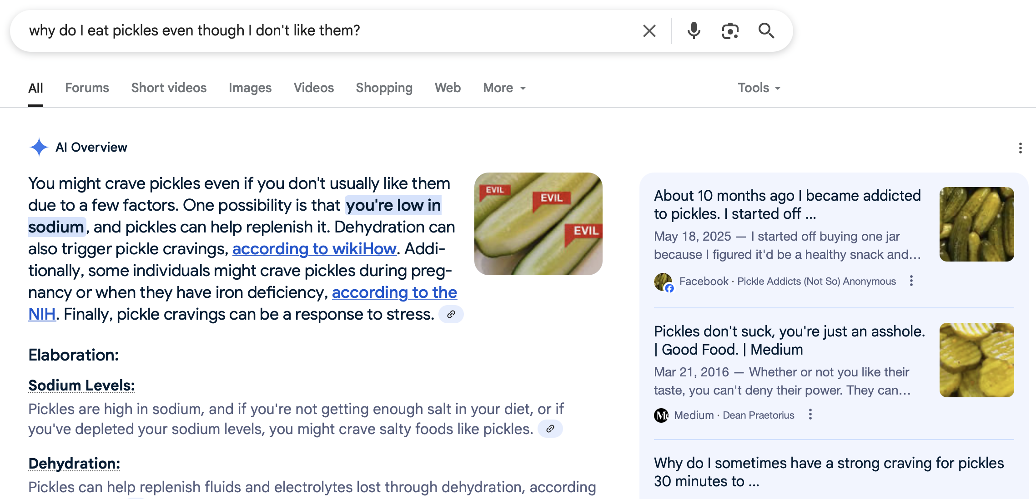
The new google
1
3
2
Query
“Ground truth” – source of data to be ingested by LLM
LLM’s summary of data relevant to the query.

Slide 7
Google’s RAG
Retrieval – Articles relevant to your query are found and retrieved from The Internetz
Augmented - The LLM’s general ‘knowledge’ is augmented with specific information from retrieved articles
Generation - The LLM generates a response based on the augmented information

Slide 8
Why do we need RAG?
LLMs foundation knowledge is insufficient
The data you’re looking at may not be in the original training data
The data sources may not be salient enough to be encoded in the model
The LLM’s context window is limited
In theory, you could provide all your data to the model
But it doesn’t have the capacity to process it
So we need to be more selective

Slide 9
RAG Examples
Google’s new results
You have a large dataset of academic papers from one discipline, and want to do a literature review or a metareview, or find if someone has published something similar to you, or just build knowledge based on unknown ideas
You have a collection of medical images, and want to find the ones that better match a patient’s textual description
You have a collection of movie scripts, and want to summarize dialogue on climate change in postapocalyptic film
etc...

Slide 10
How does RAG work?
Create a database to take data from
This is like a library, the ultimate source of information
For a given query, find the relevant elements from the database above
This is like finding specific books or papers in the library
Provide to the LLM only the relevant data, and let it work
This is like a graduate student of your own doing literature review for you 🫠

Slide 11



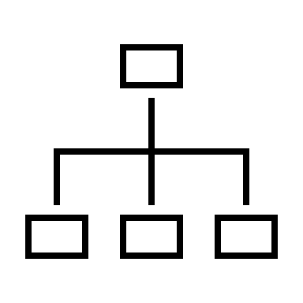
RAG Flow Diagram
Original Data
Query
Generation
Vector Database
Index

Slide 12
The devil is in the details
How do we know which parts of the data are more relevant to the query?
→ Not a trivial task!
But efrén, I read Borges’ “The Library of Babel”...
Is there an efficient way of finding the data we’re looking for?
The ultimate cypher, the index of all books?

Slide 13
Understanding RAG

Slide 14
Concept 1 - Embeddings
Embedding refers to the process of representing a word, text or full document as a mathematical vector
By doing so we can manipulate unstructured objects (text) as if they had mathematical structure
Importantly, we get a sense of which words, sentences, or documents are close to each other!! (see next concept)

Slide 15
Embeddings example – words
Chimpanzees, gorillas, and orangutans have been living for hundreds of thousands of years in the forest, living fantastic lives.
(Jane Goodall)
Gorillas
Chimpanzees
Orangutans
Forest

Slide 16


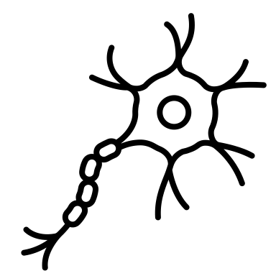




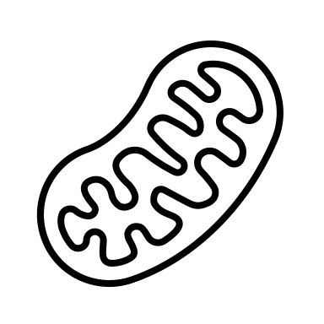




Embeddings example – Documents

Slide 17
Embeddings example – Documents

Slide 18
Embeddings example – Documents

Slide 19
Embeddings example – Documents

Slide 20



Embeddings example – Documents
Notes:
Does this look familiar to those who came to topic modeling??

Slide 21
Not only text!
You can have embedding models for:
Text
Images
Video
Audio
Other, more exotic data types
Multimodal (combinations of the above)

Slide 22
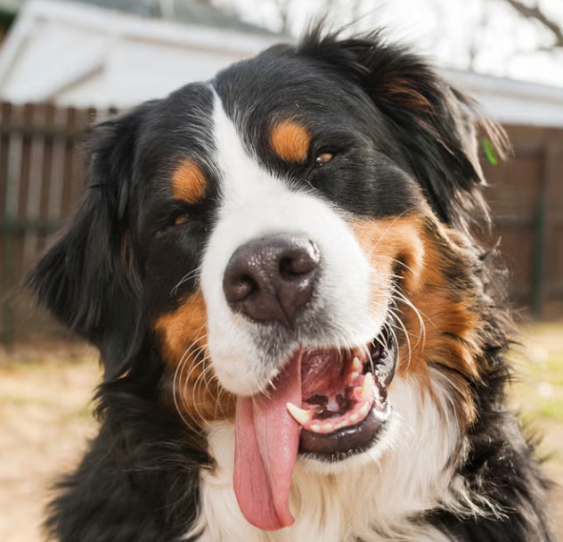


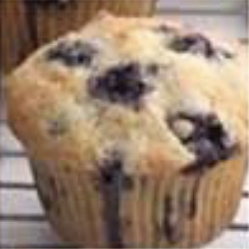

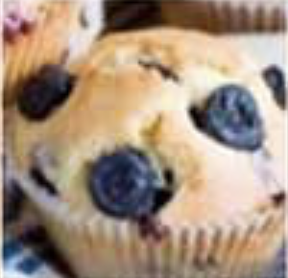
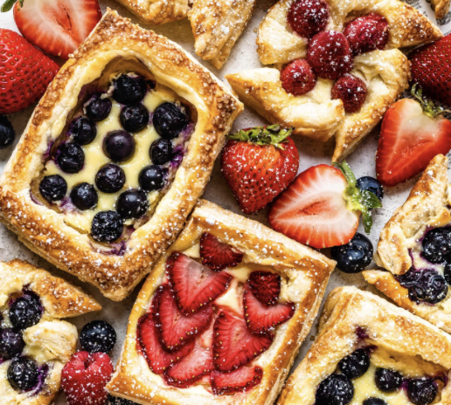




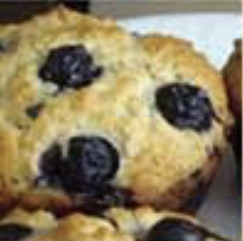
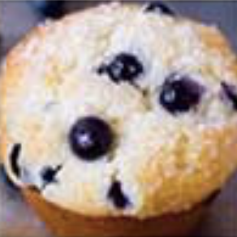
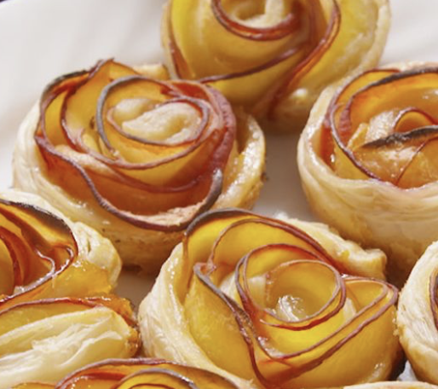
Images

Slide 23
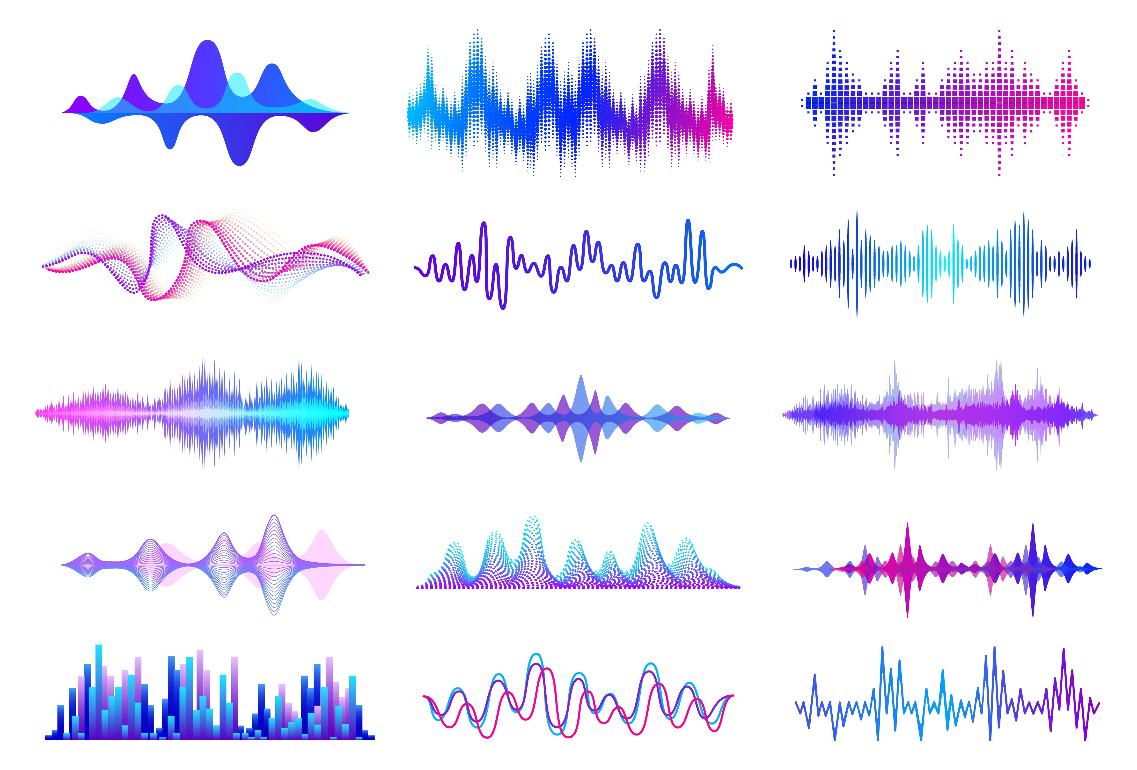

Audio
Spongebob
Scooby Doo
Morgan Freeman
Adele
efrén

Slide 24
Audio
Spongebob
Scooby Doo
Morgan Freeman
Adele
efrén

Slide 25
Audio
Spongebob
Scooby Doo
Morgan Freeman
Adele
efrén

Slide 26
Audio
Spongebob
Scooby Doo
Morgan Freeman
Adele
🤔
sus ...
efrén

Slide 27
Concept 2 – Distance and Similarity
Once data is represented as vectors we can measure how close one point is from another
→ Through a distance or a similarity
The most common approaches are:
Euclidean distance
Cosine similarity

Slide 28
Euclidean distance
Good ‘ol distance we all know and love
Which points are close to each other, and which are far?

Slide 29
Euclidean distance
Far
Close

Slide 30
Cosine similarity
Measures angle between vectors
Which points are more angle-similar to each other?

Slide 31
Cosine similarity
Measures angle between vectors
Close
Far

Slide 32
Note!
For “similarities”, higher similarity means closer (opposite of distances)
The highest cosine similarity (two vectors align perfectly) is 1
Close (high similarity)
Far (low similarity)

Slide 33
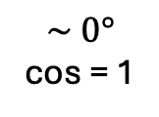
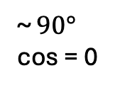
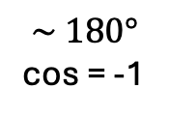
Cosine Similarity
~ $90°$
cos = 0
$$\sim 0°$$
cos = 1
$$\sim 180°$$
cos = -1

Slide 34
Why cosine in text?
Here, angle matters more than magnitude!
ESPN episode
ESPN Italy?
Mentions of balls
ESPN football article
Meatball recipe
IKEA’s cooking book
Mentions of tomato sauce

Slide 35
Why cosine in text?
Here, angle matters more than magnitude!
ESPN episode
ESPN Italy?
Mentions of balls
ESPN football article
Meatball recipe
IKEA’s cooking book
Mentions of tomato sauce

Slide 36
Concept 3 – Search
To find the most relevant points to my query, I could...

Slide 37
Concept 3 – Search
1. Compute the distance to all points

Slide 38
Concept 3 – Search
1. Compute the distance to all points
Euclidean distance

Slide 39
Concept 3 – Search
2. Determine which are closest.
Euclidean distance

Slide 40
Concept 4 – Search
3. And retrieve only the chosen ones.
Query
Relevant Information

Slide 41
Search
But this is not very efficient, and becomes prohibitive with large datasets and a large number of queries. So we need to organize information to find things faster.
This is akin to your searching for a book at a library, you don’t go book by book until you find the one. You use the library indexing system to go to the correct floor, then the correct section, then the stand, etc...

Slide 42
Concept 4 - Indexing
Indexes are structures that help you search more effectively.
There are different types of indices, and we won’t go over their specifics, but we can develop intuition with a simple example.

Slide 43
Indexing
Query
Data Point

Slide 44
Indexing
Query
Data Point
Cluster (Euclidean)

Slide 45
Indexing
Query
Data Point
Cluster (Euclidean)
Cluster representative

Slide 46
Indexing
Query
Data Point
Cluster (Euclidean)
Cluster representative

Slide 47
Indexing
Much faster to only compute distances to stars first.
And skip completely the clusters that are too far away.

Slide 48
Indexing
The cosine case is conceptually the same, but in terms of cosine similarity
Query
Data Point
Cluster(Cosine)
Cluster representative

Slide 49
Models and tools

Slide 50
The transformer
Encoder
Encoder Only
Decoder
Decoder Only

Slide 51
The transformer
Encoders
These models allow us to perform embeddings!
mpnet, miniLM, nomic, etc.
Decoders
These models allow us to generate new text
llama, olmo, gemma, gpt, etc.

Slide 52
Indexing tools
We will be using:
faiss (facebook ai similarity search)
But there are others:
mongodb, chroma, etc.

Slide 53
Summary

Slide 54
Index Search
Query
🗣️

Slide 55
Original Data
Vector Database
Embedding

Slide 56
RAG Flow Diagram
Original Data
Query
Generation
🗣️
Embedding
Embedding
- Indexing
- Search
Relevant Results
Vector Database
Index

Slide 57
Querying Strategies

Slide 58
Extra Material

Slide 59
Concept 4 – Normalization
Scaling vectors so they have length 1
1
1

Slide 60
Concept 4 – Normalization
Scaling vectors so they have length 1
1
1

Slide 61
Concept 4 – Normalization
They now live in the unit circle!!
1
1

Slide 62
Concept 4 – Normalization
IF vectors are normalized:
“Closest” Euclidean-wise is the same as “Most similar” cosine-wise
1
1

